Slide 1
How technology can be used for good health using Millet?
DIVISION: B
NAME: AYUSH.D.REWATKAR
ROLL NO: 254
PRN NO: 202201040033

Slide 2
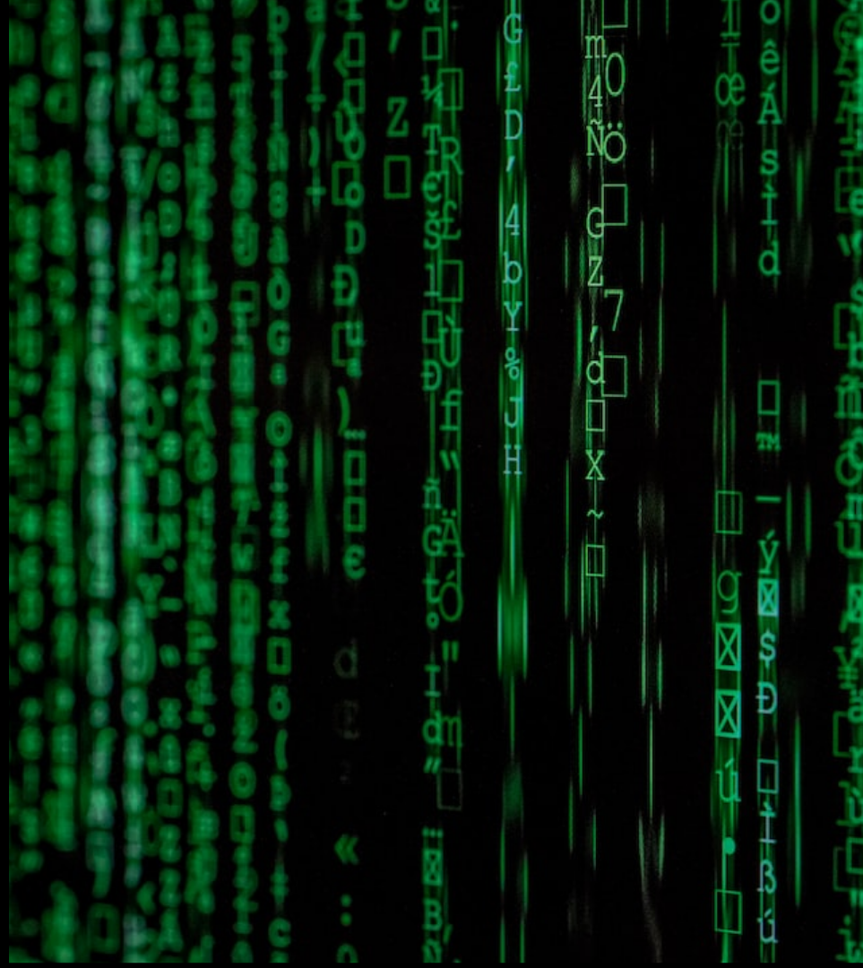
1.Introduction to Millet
Technology offers innovative ways to improve industrial health, and millet applications are increasingly proving to be useful in this regard. In this presentation, we will explore how leveraging technology to manage optimization of health yields positive impacts in industrial areas.

Slide 3

2. Millet Nutritional Benefits
Millet provides a variety of essential nutrients. It helps to control hunger while providing essential minerals and vitamins like iron, calcium, magnesium unlike other cereals. It also aids in regular digestion and prevents discoloration. Moreover, millet helps in maintaining healthy cholesterol levels.

Slide 4
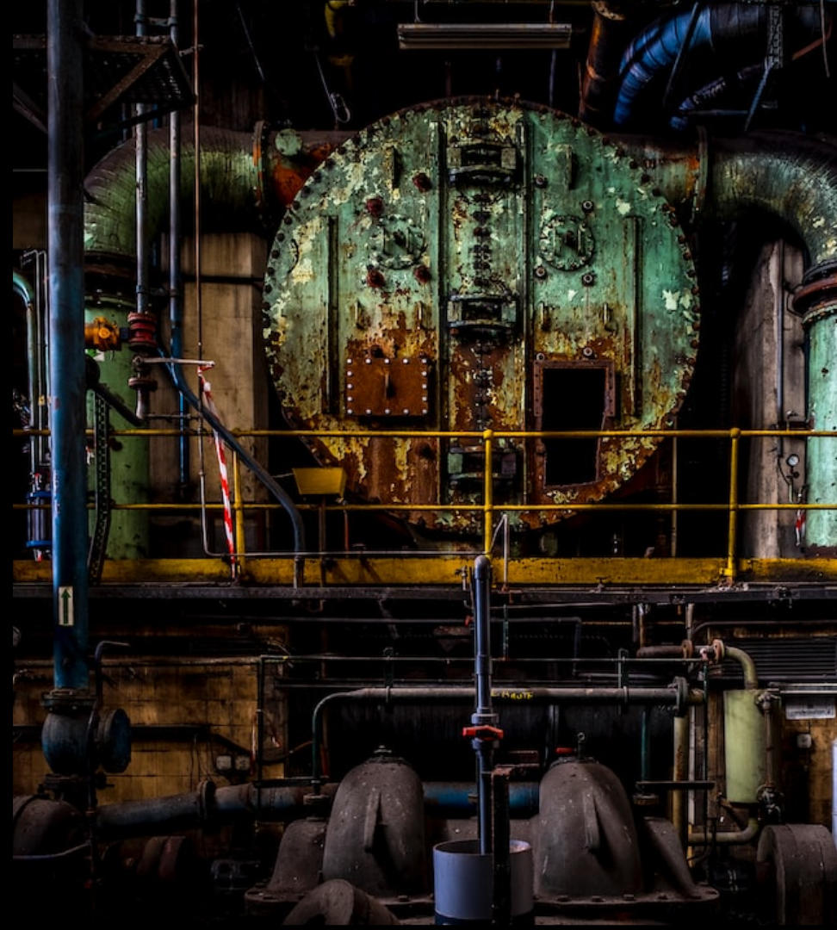
3. Millet for Optimal Health
Millet can leverage technology so that industrial areas can reduce their health risk. It can help in improving the oxygen practices in industries, be added to diets, and help to improve respiratory health in workers. Consumption of millet can help improve respiratory functions and quality of life by preventing discoloration and by controlling cholesterol, improving digestion of workers in industrial areas.

Slide 5
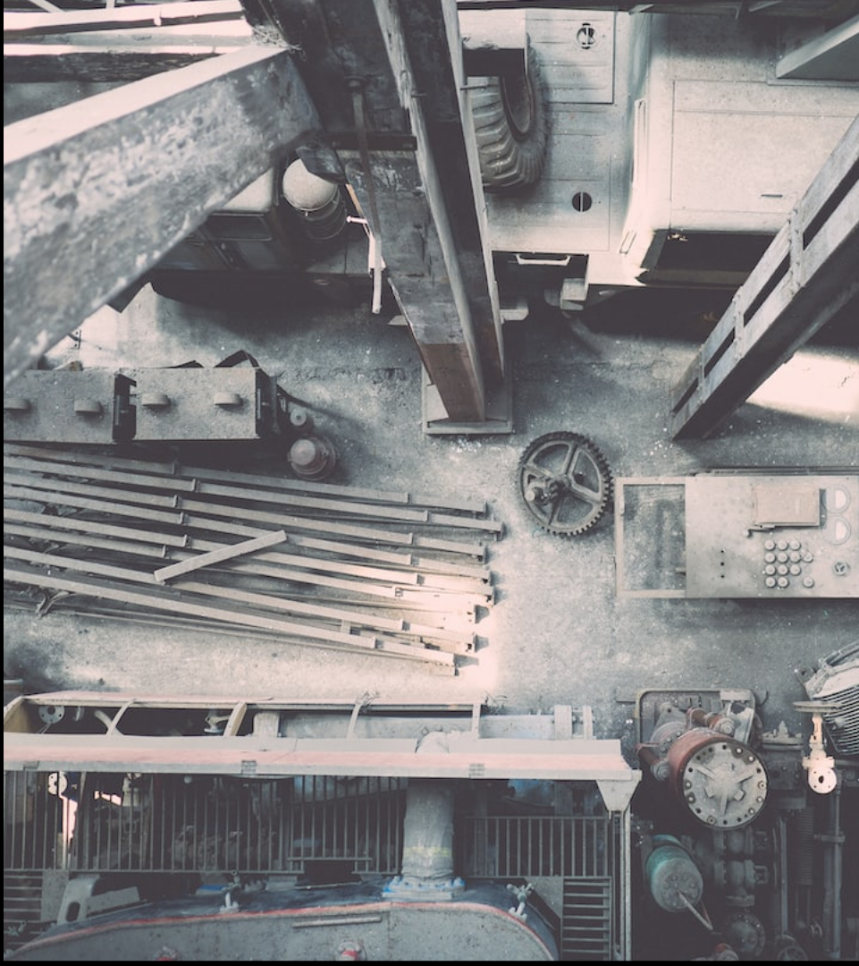
4. Innovative Millet Applications
Millet Applications aim to raise health awareness in industrial areas. By using advanced technologies like AI, cloud computing and machine learning, Millet Apps can develop personalized diet plans and help diagnose respiratory conditions. These Apps also enable users to order medicines directly to their doorsteps, and seek out medical advice from experts. With the help of Millet Applications, workers in industrial areas can take proactive steps towards better health.

Slide 6
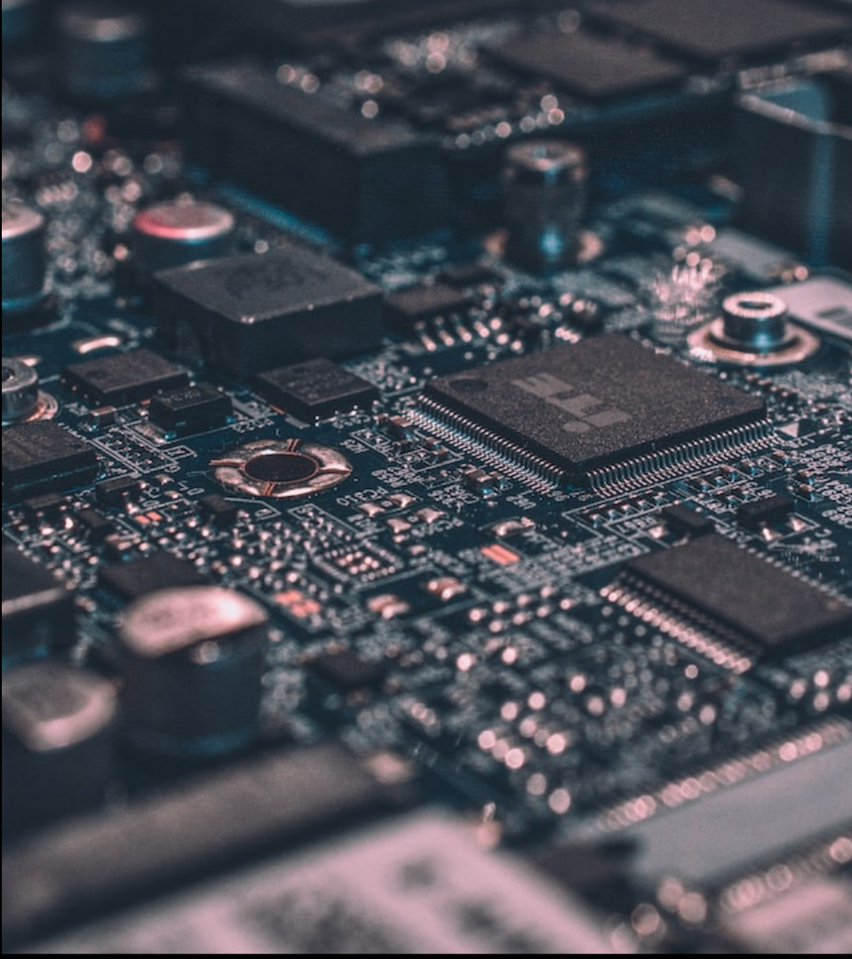
5. Millet in Industrial Areas
Millet Apps are a combination of advanced technologies and analytics that help industrial workers take control of their health. By providing access to nutritional advice, identification of respiratory conditions, possibility to access medicine delivery and seeking out expert advice, Millet Apps give workers the opportunity to optimize their health and prevent serious complications.

Slide 7
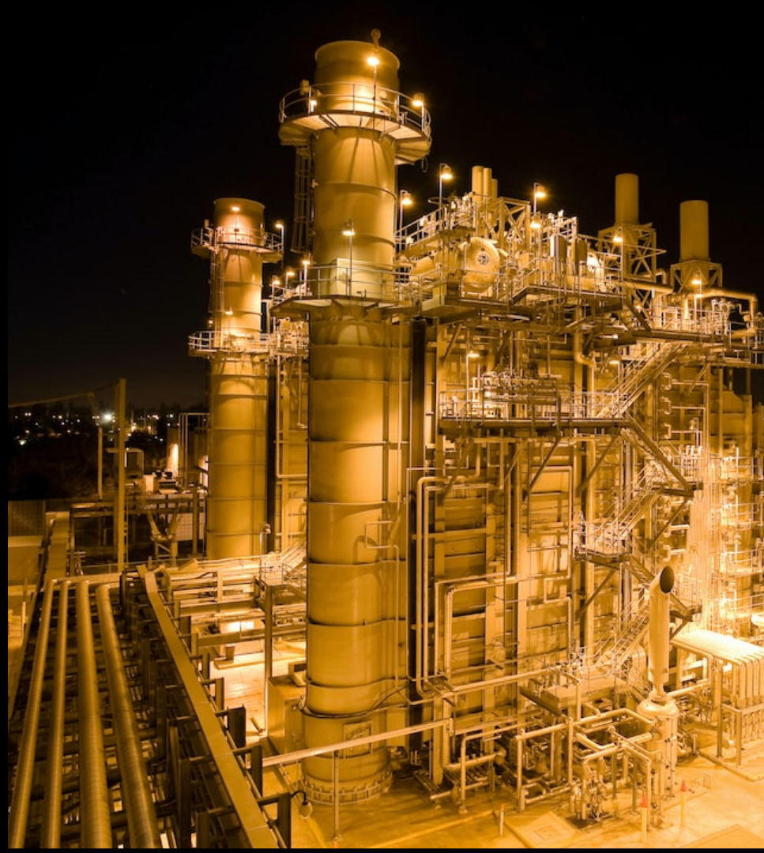
6. Technology Advancements
The powerful combination of IOT, 9th generation sensors, computational databases and machine learning algorithms allow millet apps to provide prompt and accurate health recommendations to industrial workers. These technologies also provide much needed insight into the health and safety of workers as well as preventative insights into how health issues can be avoided with minimal effort.

Slide 8
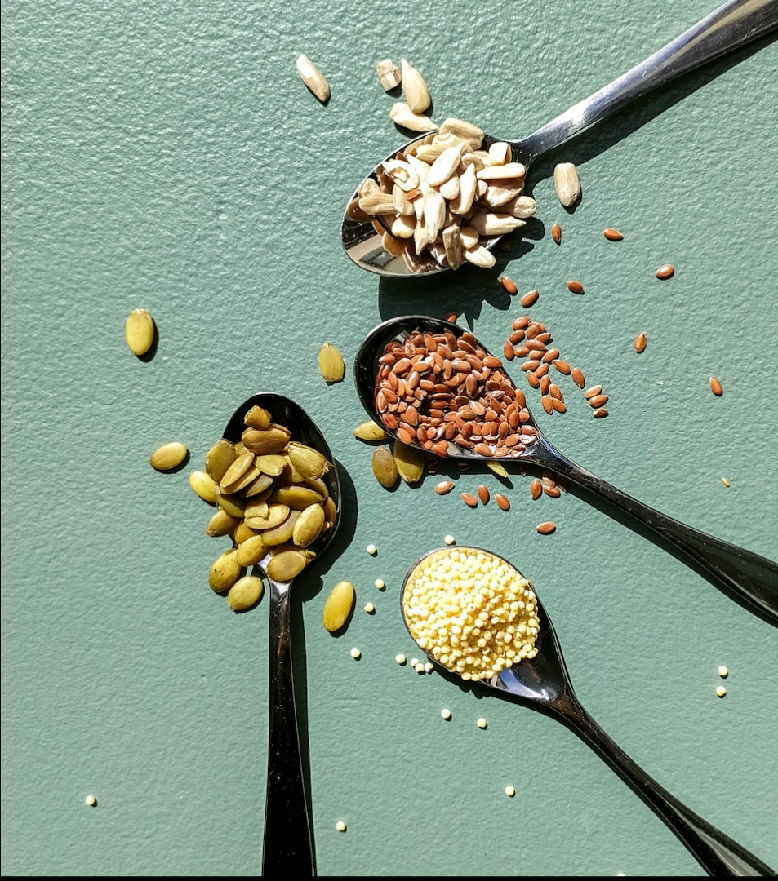
7. Leveraging Technology
Millet Apps provide a way to leverage the latest technology to optimize health and safety. These advanced technologies allow us to quickly analyze data, gain deeper insights and make smarter decisions. This helps ensure optimum safety and health for all industrial workers.

Slide 9
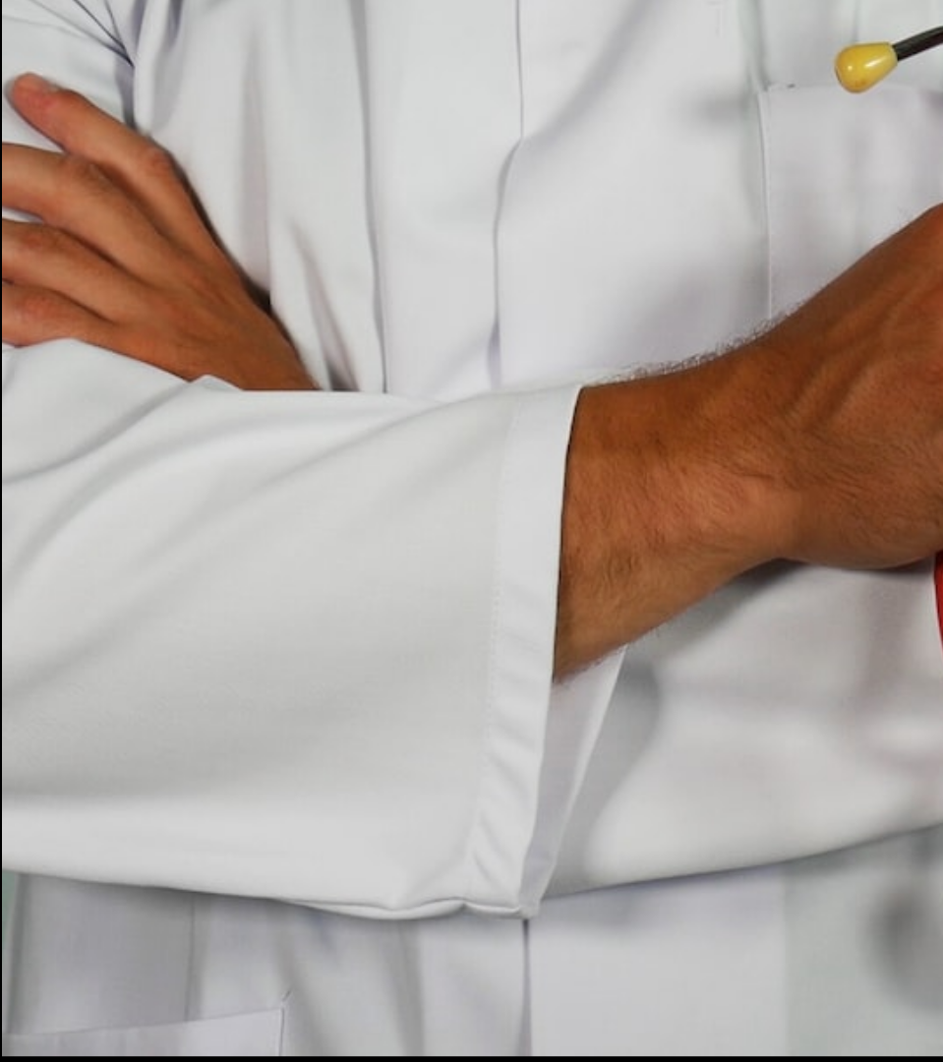
8. Case Studies: Successful Implementations
Different industrial sectors, like Mining and Chemicals are now using Millet apps to analyze the data and gain insights from it. As a result, the implementation of Millet apps in these sectors have improved safety standards and optimized health. Case studies from different industries demonstrate the success of Millet app implementations.

Slide 10
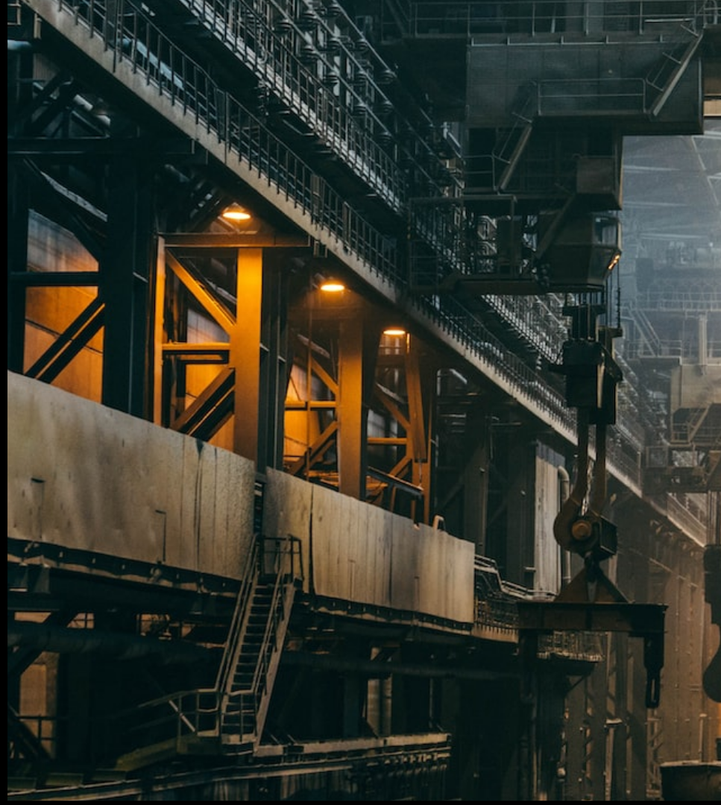
9. Future Growth Prospects
Deploying Millet apps in industrial sectors has the potential to save significant amount of resources and money. With the help of Millet apps, industrial industries are able to gain access to real-time data insights during their operations. This implies that the implementation of Millet app solutions could create more value and lead to more sustainable and profitable production.

Slide 11
10. Conclusion
By leveraging Millet apps, industries can work towards improving performances and minimizing
the risks associated with inefficiency, thus leading to more effective production with increased transparency. Further research will be done to understand the better dynamics and outcomes of Millet apps deployment in industrial areas.

